Slide 1
W205 Storing and Retrieving Data Work In Progress

Slide 2
Personal Goals:
Be able to explain and deploy key data architectures. More specifically,
HDFS + Hive
HDFS + Spark (Pyspark, Spark SQL)
PostgreSQL (RDBMS)
Tweepy + Storm
Architecture – components and typcail architectures

Slide 3
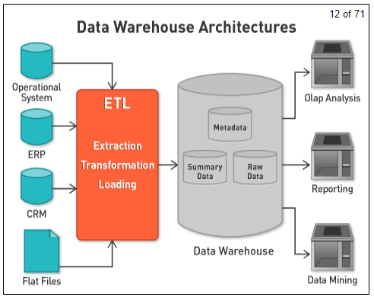
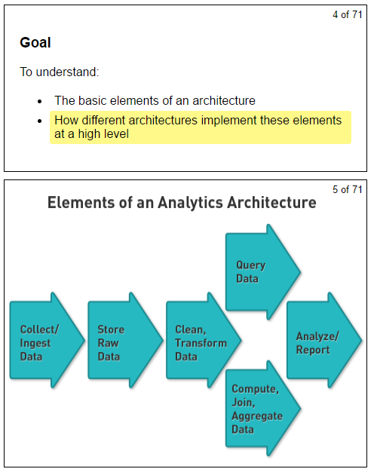
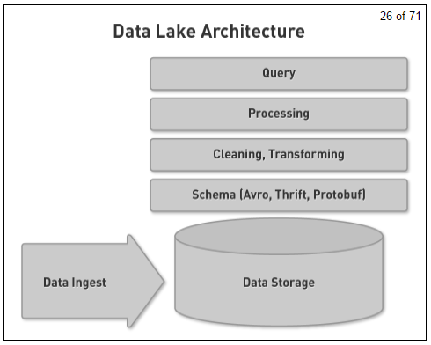

Slide 4
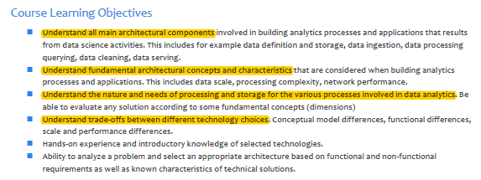

Slide 5
Course
Unit1. Course intro and architecture
Unit2. Dimensions and scaling: understanding trade-offs
Unit3. Structure and organization
Unit4. Data lakes: storage and maintenance
Unit5. Data ingestion: storage and maintenance
Unit6: Data processing and aggregation
Unit7: Querying data
Unit8: Exploring data
Unit9: Streaming data
Unit10: Cleaning data, entity linkage, string clustering and fuzzy methods for merging datasets
Unit11: Graph models and analysis
Unit12: Serving data
Unit13: Advanced topics
Unit14: Course wrap-up

Slide 6
Lab
Lab0 command line
Lab1 EC2 instance
Lab2 HDFS
Lab3 Apache Hive, Spark SQL
Lab4 Apache Spark
Lab5 PostgreSQL
Exercise1 Hive + (Pyspark)
Exercise2 Set up a stream processing pipeline – Apache Storm
Lab6 Apache Storm
Lab7 Hive + Tableau

Slide 7
Key words
Apache Hadoop is a processing framework – Batch processing
HDFS is the distributed filesystem layer that coordinates storage and data replication across the cluster nodes
YARN is a recourse manager for Hadoop
MapReduce is Hadoop’s native batch processing engine
Apache Spark is a next gen batch processing framework with stream processing capabilities.
Resilient Distributed Datasets (RDDs)
Apache Storm is a stream processing framework for near real-time processing.
Storm stream processing works by orchestrating DAGs in a framework it calls topologies that are composed of Streams, Spouts, and Bolts

Slide 8
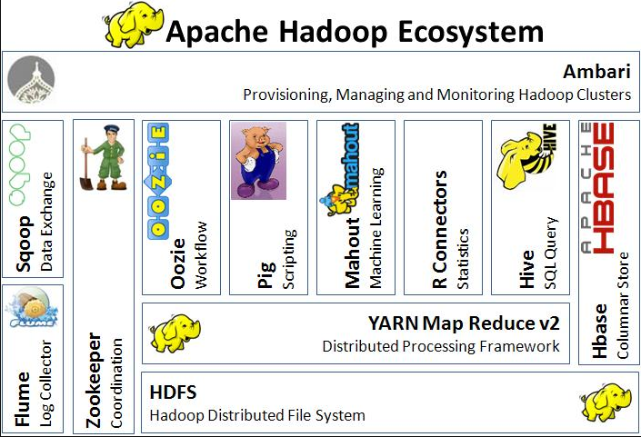
Apache Hadoop Ecosystem Key words: Storage + MapReduce + Data Replication, Batch processing

Slide 9
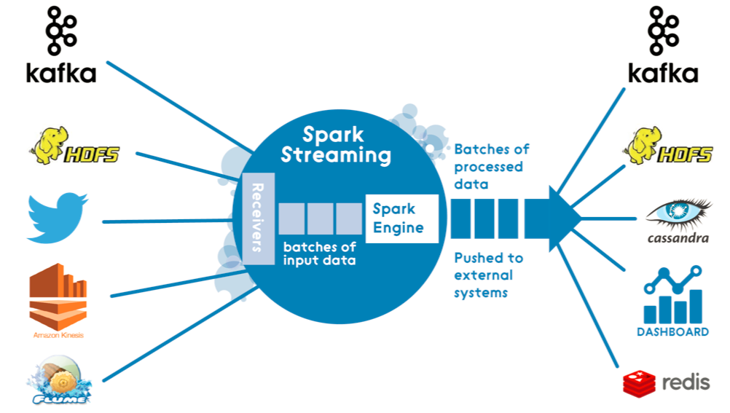
Apache Spark Fast and general engine for large-scale data processing Key words: In memory, RDD, Batch processing +

Slide 10
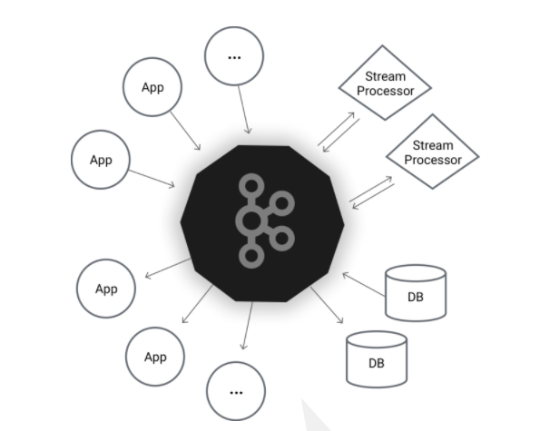
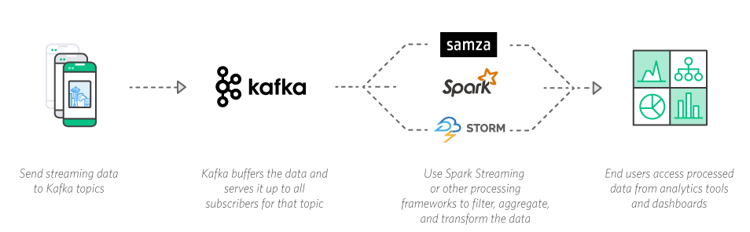
Apache Kafka A distributed streaming platform Key words: Log
Kafka™ is used for building real-time data pipelines and streaming apps. It is horizontally scalable, fault-tolerant, wicked fast, and runs in production in thousands of companies.

Slide 11
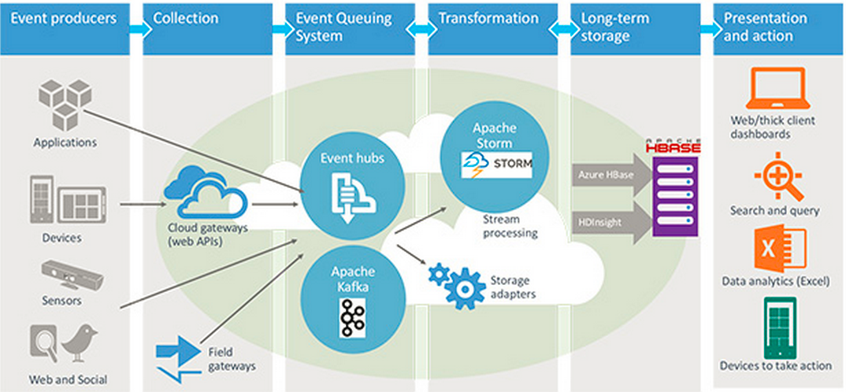
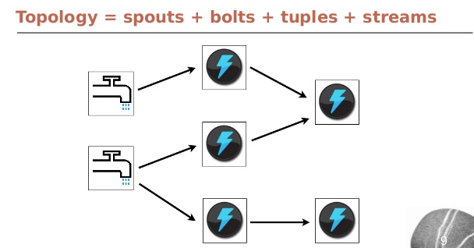
Apache Storm Key words: real-time processing

Slide 12
Week1 Learning2 Horizontal scaling(scale out)
Several years ago, building performance into a software system was simple - you either increased your hardware resources (scale up) or modified your application to run more efficiently (performance tuning). Today, there’s a third option: horizontal scaling (scale out).
Horizontal scaling of software systems has become necessary in recent years, due to the global nature of computing and the ever-increasing performance demands on applications. In many cases, it is no longer acceptable to run a single server with a single database in a single data center adjacent to your company’s headquarters. We need truly distributed environments to tackle the business challenges of today.
Unfortunately, the performance benefits that horizontal scaling provides come at a cost - complexity. Distributed systems introduce many more factors into the performance equation than existed before. Data records vary across clients/nodes in different locations. Single points of failure destroy system up-time, and intermittent network issues creep up at the worst possible time.

Slide 13
Week1 Learning - Nodes
Distributed system nodes[edit]
If the network in question is a distributed system, the nodes are clients, servers or peers. A peer may sometimes serve as client, sometimes server. In a peer-to-peer or overlay network, nodes that actively route data for the other networked devices as well as themselves are called supernodes.
Distributed systems may sometimes use virtual nodes so that the system is not oblivious to the heterogeneity of the nodes. This issue is addressed with special algorithms, like consistent hashing, as it is the case in Amazon's.^{[2]}
End node in cloud computing[edit]
Within a vast computer network, the individual computers on the periphery of the network, those that do not also connect other networks, and those that often connect transiently to one or more clouds are called end nodes. Typically, within the cloud computing construct, the individual user / customer computer that connects into one well-managed cloud is called an end node. Since these computers are a part of the network yet unmanaged by the cloud's host, they present significant risks to the entire cloud. This is called the End Node Problem.^{[3]} There are several means to remedy this problem but all require instilling trust in the end node computer.^{[4]}

Slide 14
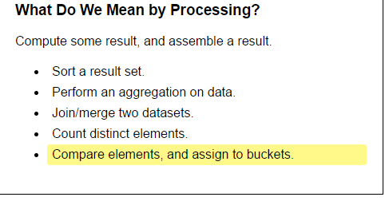
Week1 Learning - Processing

Slide 15
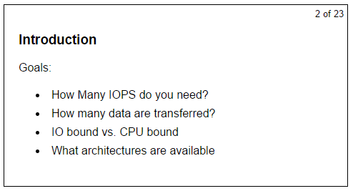
Week1 - Scaling Processing

Slide 16
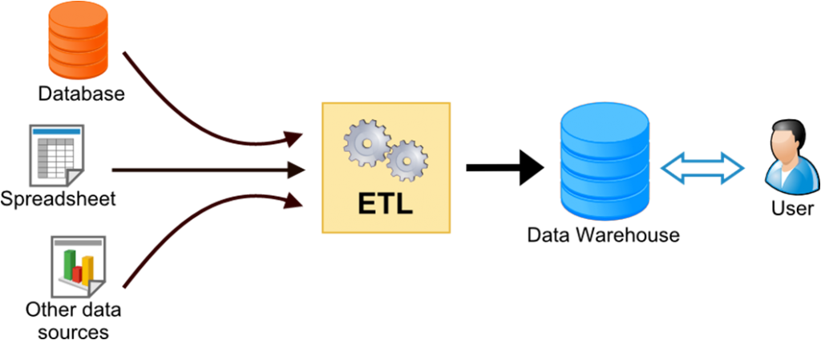
Week1 Learning 1 ETL (Extract, Transform, and Load)
ETL (Extract, Transform and Load) is a process in data warehousing responsible for pulling data out of the source systems and placing it into a data warehouse.

Slide 17
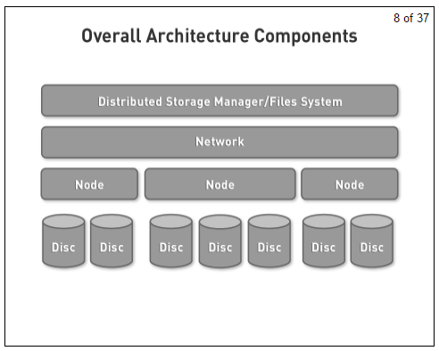
Architecture

Slide 18
Storage
Node attached block storage --- cannot scale storage or processing
Storage area network(SAN) --- scale up, NOT scale out
Network attached storage
Network file system (NFS) – scale up (NOT scale out)
Software defined storage (swift, Amazon s3)
HDFS type storage

Slide 19
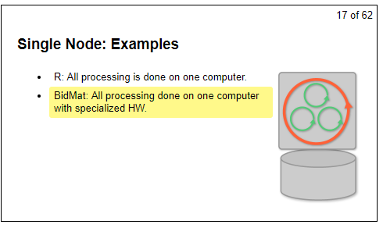
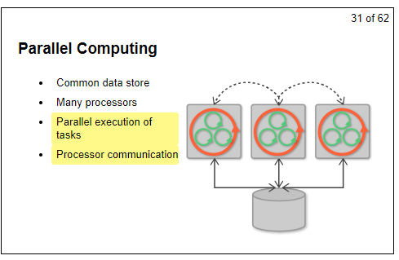
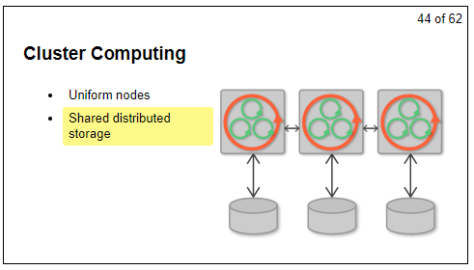
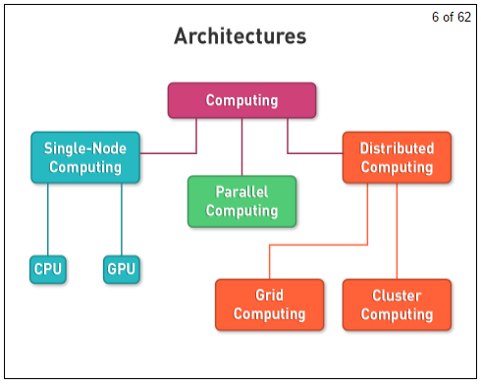
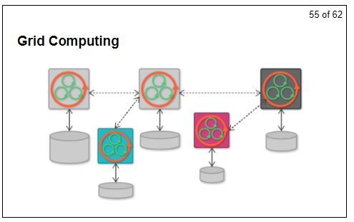
Architecture
Single-node computing --- CPU, GPU
Parallel computing
Distributed computing – connected processors collaborate to achieve a common goal
Cluster computing --- Hadoop, Spark. Uniform nodes, Shared distributed storage
Grid computing --- distributed nodes, heterogeneous and physically separate nodes

Slide 20
Week 2 Learnings1 – CAP theorem
In distributed system, you can only have two out of the three guarantees in writing and reading. Consistency, Availability, and Partition Tolerance.
Consistency: A read is guaranteed to return the most recent write.
Availability: A non-failing node will always return a response.
Partition Tolerance: the system will continue to function when network partitions occur.
In reality, we cannot sacrifice partition tolerance. It’s trade off between consistency and availability
http://robertgreiner.com/2014/08/cap-theorem-revisited/

Slide 21
Week 2 Learnings2 – Lambda architecture
Lambda architecture is an data processing architecture for big data
The Batch layer: manages the master data and precomputes the batch views.
The speed layer: focuses on recent data only and increments the real-time views.
The serving layer: indexes and exposes the views so that the data can be queried.

Slide 22
Lambda architecture - Example
Apache Hadoop provides both reliable storage (HDFS) and a processing system (MapReduce) for large data sets across clusters of computers. MapReduce is a batch query processor that is targeted at long-running background processes. Hadoop can handle Volume. But to handle Velocity, we need real-time processing tools that can compensate for the high-latency of batch systems, and serve the most recent data continuously, as new data arrives and older data is progressively integrated into the batch framework.
Therefore we need both batch and real-time to run in parallel, and add a real-time computational system (e.g. Apache Storm) to our batch framework. This architectural combination of batch and real-time computation is referred to as a Lambda Architecture (λ).

Slide 23
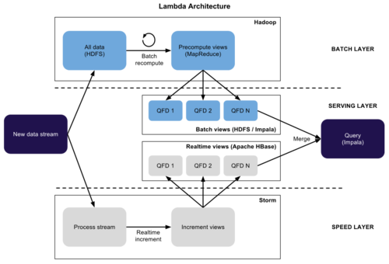
Lambda Architecture for Big Data
A generic, scalable and fault-tolerant data processing architecture
The Batch Layer manages the master data and precomputes the batch views
e.g. Apache Hadoop
The Speed Layer serves recent data only and increments the real-time views. the speed layer is responsible for filling the "gap" caused by the batch layer's lag in providing views based on the most recent data.
e.g. Apache Storm, Apache Spark
The Serving Layer is responsible for indexing and exposing the views so that they can be queried.
http://jameskinley.tumblr.com/post/37398560534/the-lambda-architecture-principles-for
https://dzone.com/articles/lambda-architecture-big-data

Slide 24
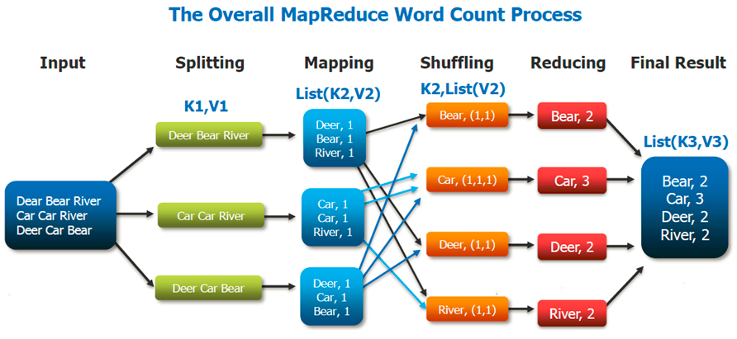
MapReduce
MapReduce is a core component of the Apache Hadoop software framework.
Hadoop enables resilient, distributed processing of massive unstructured data sets across commodity computer clusters, in which each node of the cluster includes its own storage. MapReduce serves two essential functions: It parcels out work to various nodes within the cluster or map, and it organizes and reduces the results from each node into a cohesive answer to a query.

Slide 25
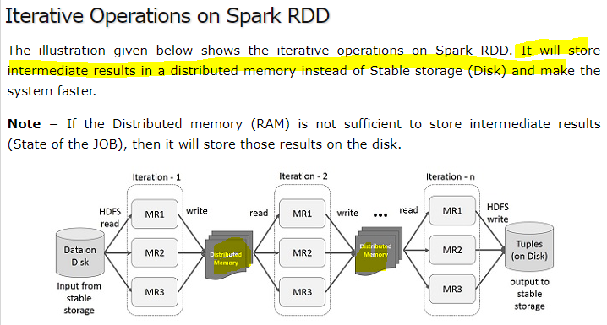
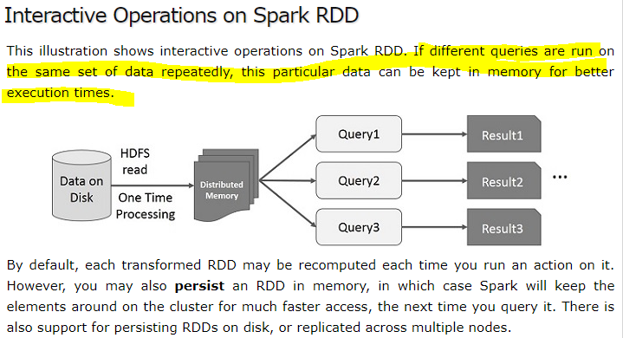
Data sharing is slow in MapReduce
Data sharing is slow in MapReduce due to replication, serialization, and disk IO. Most of the Hadoop applications, they spend more than 90% of the time doing HDFS read-write operations.
Recognizing this problem, researchers developed a specialized framework called Apache Spark. The key idea of spark is Resilient Distributed Datasets (RDD); it supports in-memory processing computation. This means, it stores the state of memory as an object across the jobs and the object is sharable between those jobs. Data sharing in memory is 10 to 100 times faster than network and Disk.
https://www.tutorialspoint.com/apache_spark/apache_spark_rdd.htm

Slide 26
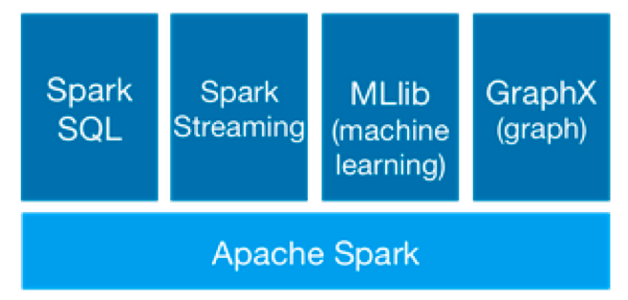
Week3 – Apache Spark
Apache Spark is a framework for real time data analytics in a distributed computing environment.
It executes in-memory computations to increase speed of data processing over Map-Reduce. (100x faster)
Spark comes packed with high-level libraries, including support for R, SQL, Python, Scala, Java etc. These standard libraries increase the seamless integrations in complex workflow. Pyspark
The core of the Spark architecture is the concept of RDDs.
Spark SQL assumes that data are structured according to a relational model, which enables us to use SQL to query the data. It provides a programming abstraction based on what is called DataFrames. Spark SQL acts as a distributed SQL query engine.

Slide 27
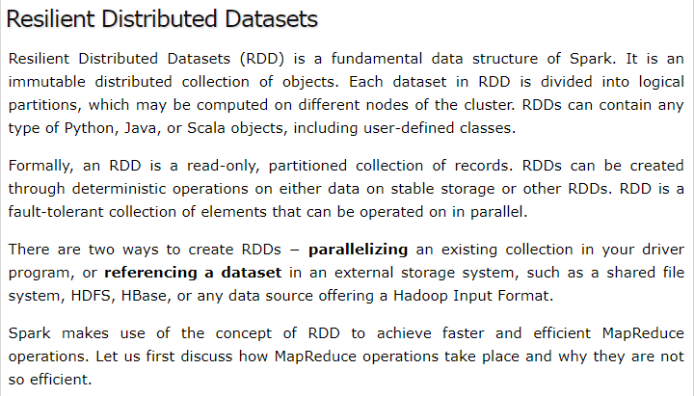
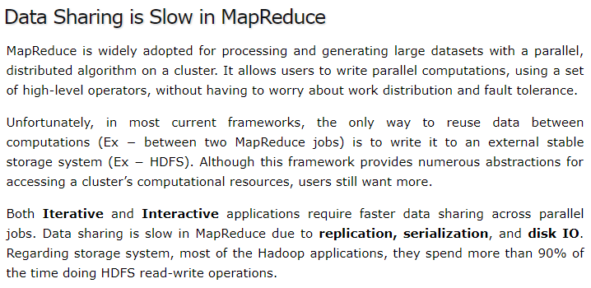
https://www.tutorialspoint.com/apache_spark/apache_spark_rdd.htm

Slide 28
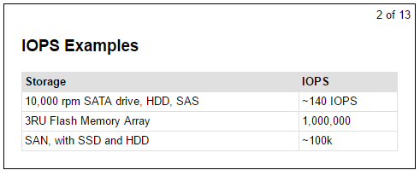
Week2 Learning3 - IOPS
Input/output operations per second (IOPS, pronounced eye-ops) is a performance measurement used to characterize computer storage devices like hard disk drives (HDD), solid state drives (SSD), and storage area networks (SAN).

Slide 29
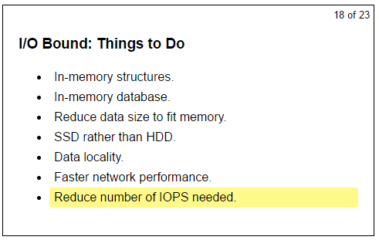
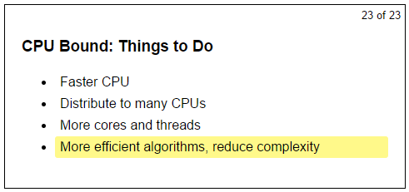
Week2 Learning3 - CPU bound / IO bound
A program is CPU bound if it would go faster if the CPU were faster, i.e. it spends the majority of its time simply using the CPU (doing calculations). A program that computes new digits of π will typically be CPU-bound, it's just crunching numbers.
A program is I/O bound if it would go faster if the I/O subsystem was faster. Which exact I/O system is meant can vary; I typically associate it with disk. A program that looks through a huge file for some data will often be I/O bound, since the bottleneck is then the reading of the data from disk.

Slide 30
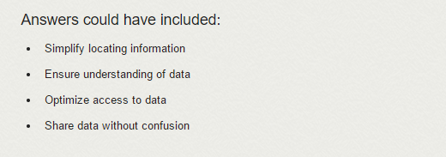
Week 3 Learnings1
Two types of schema(= a model, = a plan)
Schema-on-read: stores data without validation. The schema is applied to the data when the data is read. Advantage is schemas can mutate over time. Disadvantage is higher cost to read data and no guarantees about data contents.
E.g. Big data frameworks such as Hadoop
Schema-on-write: validates data when storing it. Advantage is data characteristics are guaranteed and lower-cost reads, and disadvantage is schema modifications is not easy.
E.g. Relational database system such as MySQL
Hybrid approach:
E.g. Apache HBase, Apache Cassandra

Slide 31
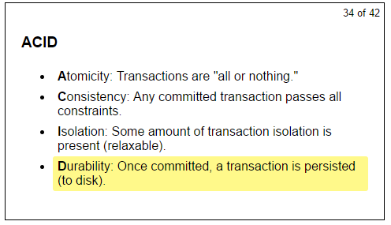
Week3 Learning2 ACID
ACID is a set of properties of database transactions.
In the context of databases, a sequence of database operations that satisfies the ACID properties and, thus, can be perceived as single logical operation on the data, is called a transaction. For example, a transfer of funds from one bank account to another, even involving multiple changes such as debiting one account and crediting another, is a single transaction.

Slide 32
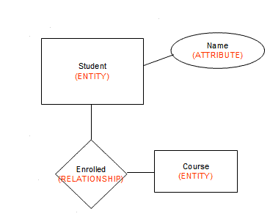
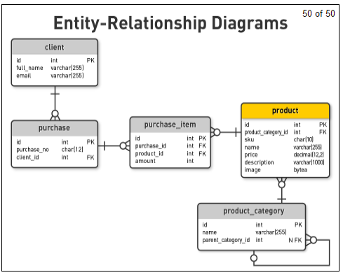
Week3 Learning3 Entity-Relationship Diagrams
A tool for database design. It presents a business data schema in graphical form. It includes entities, relationships and attributes in the chart
Primary key: the candidate key chosen to be used for identifying entities and accessing records. Unless otherwise noted "key" means "primary key“
Foreign key: term used in relational databases (but not in the E-R model) for an attribute that is the primary key of another table and is used to establish a relationship with that table where it appears as an attribute also.

Slide 33
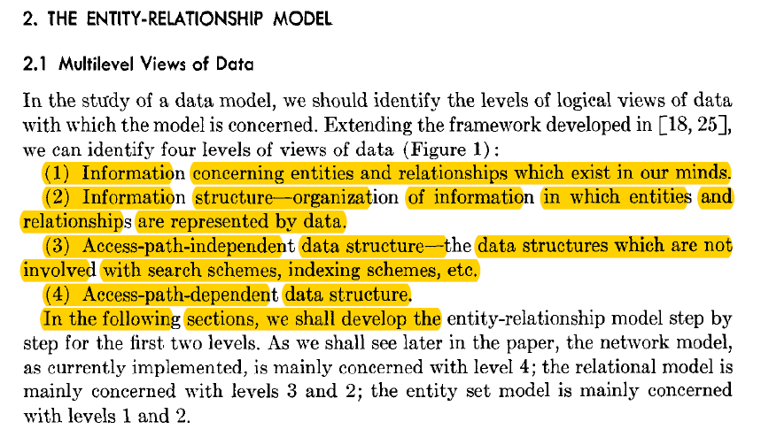
Week3 Reading

Slide 34
Normalization and denormalization
First normal form(1NF)
Second normal form(2NF)
Third normal form(3NF)
Normalized databases are designed to minimize redundancy, while denormalized databases designed to optimize read time

Slide 35
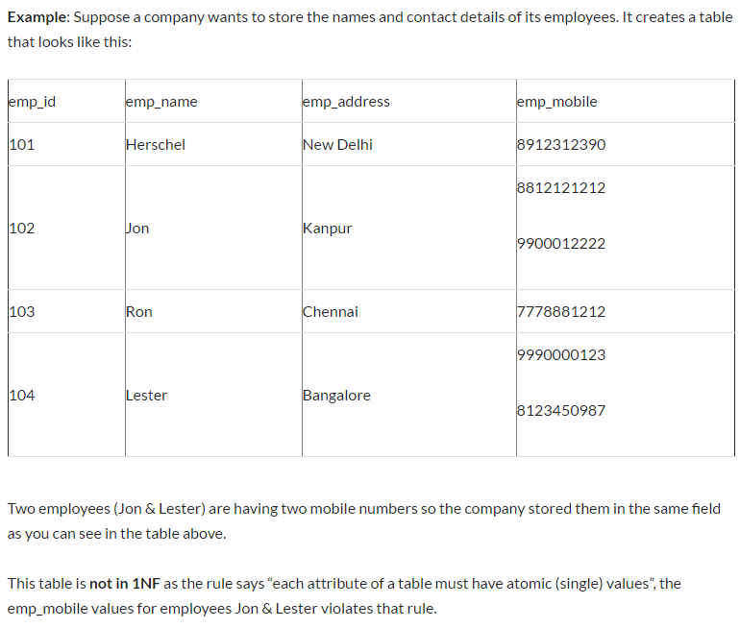
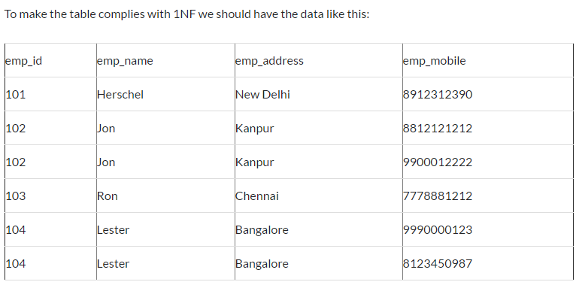
1NF – “each attribute of a table must have atomic (single values)”

Slide 36
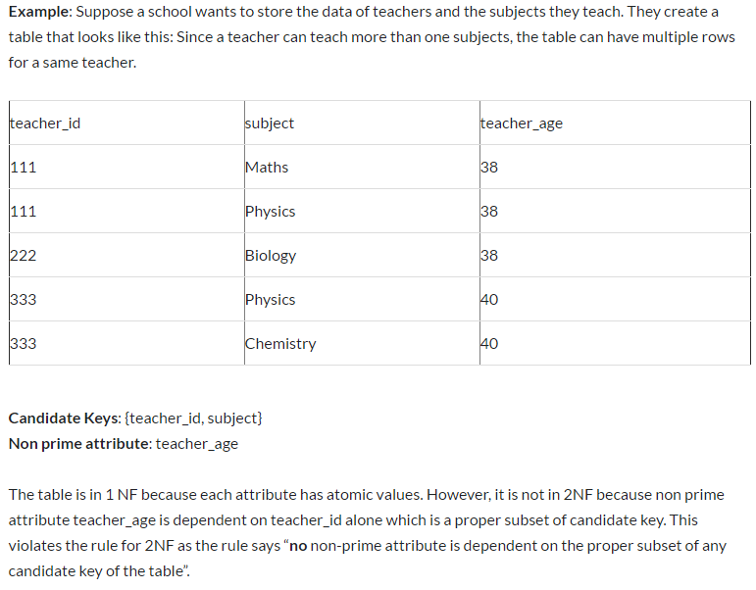
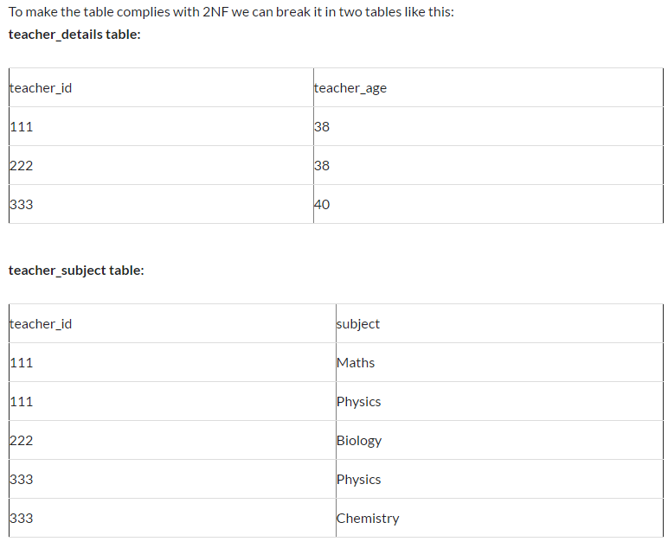
2NF

Slide 37
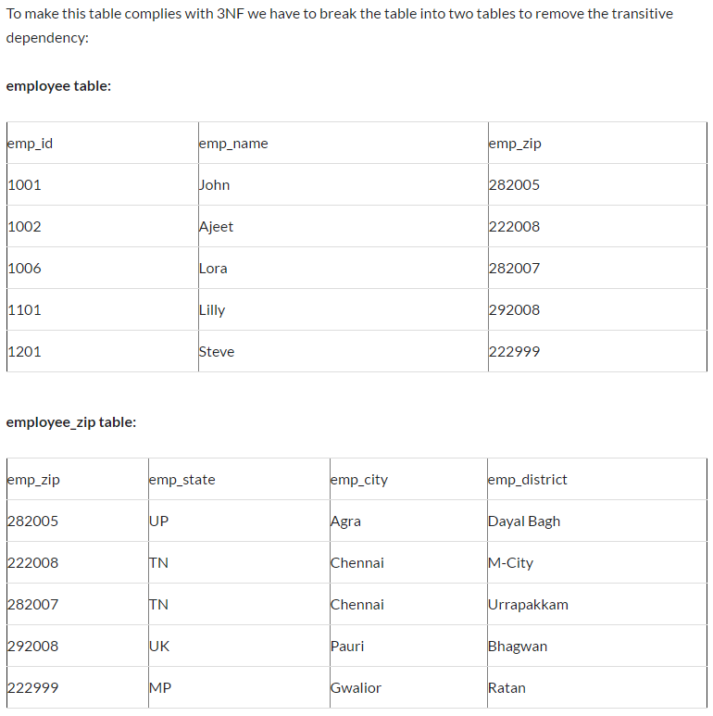
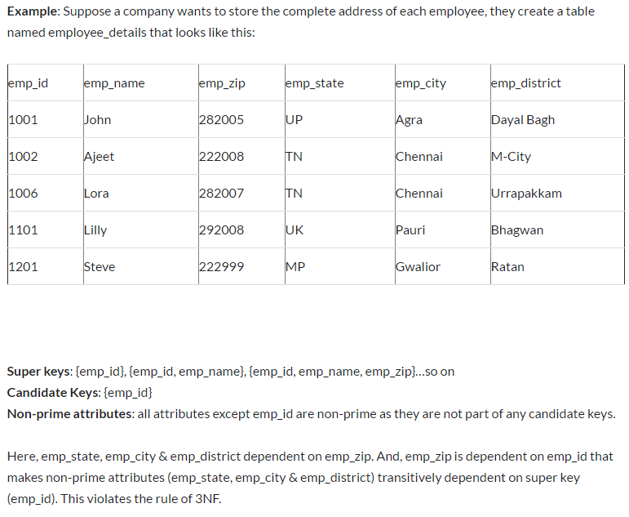
3NF

Slide 38
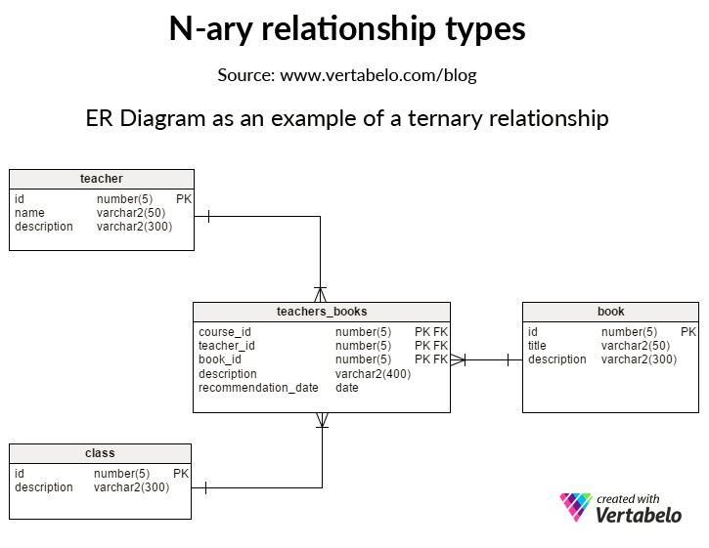

Slide 39
Week3 - Hadoop
Three things
Distributed storage called HDFS in which Hadoop automatically splits files into large blocks and distributes them across nodes in a cluster
Data replication: With the default replication value 3, data is stored on three nodes.
Processing of data using the MapReduce programming model. It performs MAP() method for filtering and sorting, and Reduce() method for summary operation.

Slide 40
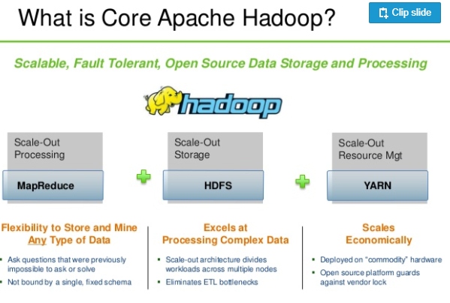

Slide 41
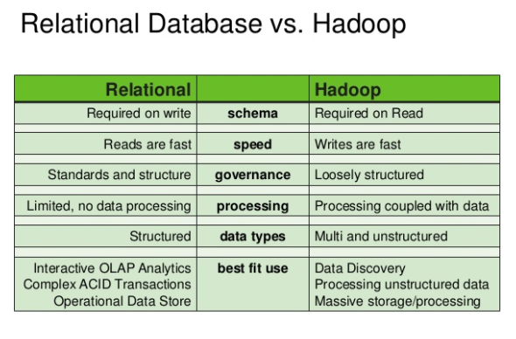

Slide 42
Week3 - Hive
HIVE is a data warehousing component which performs reading, writing and managing large data sets in a distributed environment using SQL-like interface
Hive provides an SQL-like interface to query data stored in various databases based on Hadoop.
Traditional SQL queries must be implemented in the MapReduce Java API to execute SQL applications and queries over distributed data.
Hive provides the necessary SQL abstraction to integrate SQL-like queries into the underlying Java without the need to implement queries in the low level Java API.
(Initially developed by Facebook, then used and developed by other companies now such as Netflix)

Slide 43
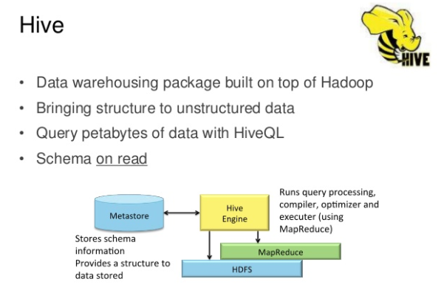

Slide 44
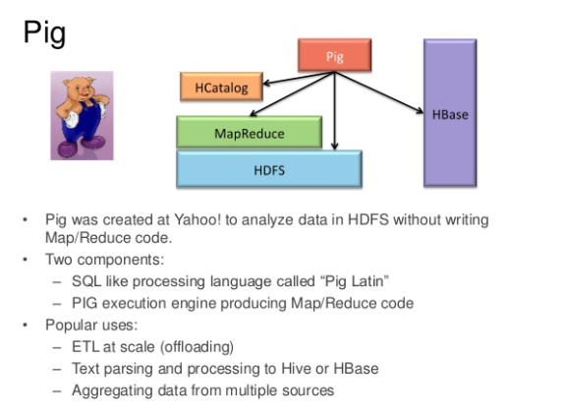

Slide 45
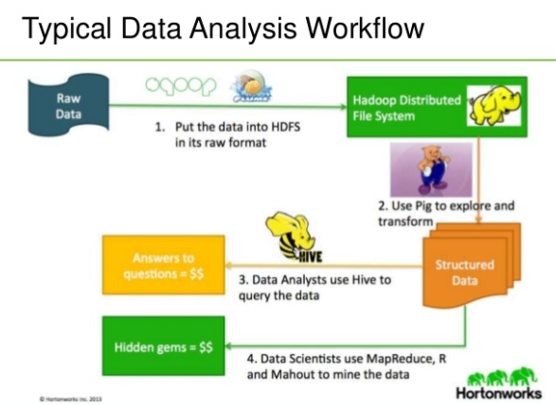

Slide 46
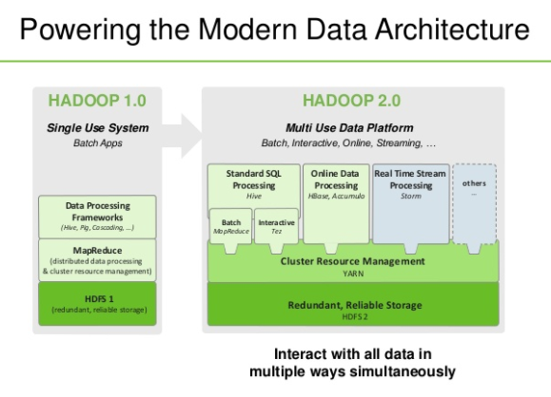

Slide 47
Week 7 Learnings1 DAG
Directed acyclic graph --- DAG
graph = structure consisting of nodes, that are connected to each other with edges
directed = the connections between the nodes (edges) have a direction: A -> B is not the same as B -> A
acyclic = "non-circular" = moving from node to node by following the edges, you will never encounter the same node for the second time.
A good example of a directed acyclic graph is a tree. Note, however, that not all directed acyclic graphs are trees.

Slide 48
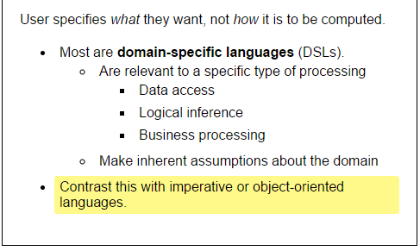
Week 7 Learnings2 – Declarative language

Slide 49
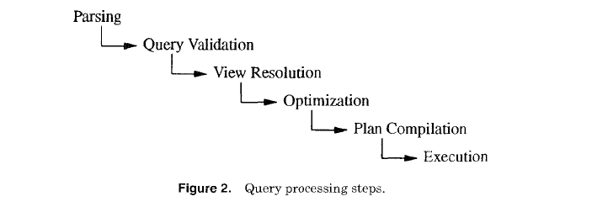
Week 7 Learning 2 – Query Optimizer
Once you write a query in declarative language such as SQL, query optimizer generate an efficient plan for the given query.
To be more specific, query optimize generates multiple execution plans , estimates the cost of each plan, and compares the costs of plans and chooses the lowest-cost plan.

Slide 50
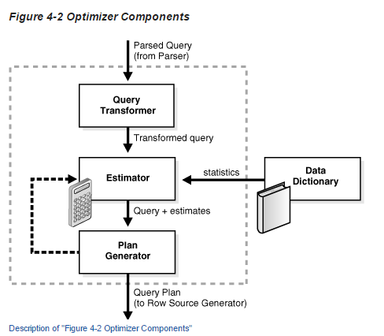
Query Optimizer
https://docs.oracle.com/database/121/TGSQL/tgsql_optcncpt.htm#TGSQL213
A set of query blocks represents a parsed query, which is the input to the optimizer. The optimizer performs the following operations:
Query transformer
The optimizer determines whether it is helpful to change the form of the query so that the optimizer can generate a better execution plan. See "Query Transformer".
Estimator
The optimizer estimates the cost of each plan based on statistics in the data dictionary. See "Estimator".
Plan Generator
The optimizer compares the costs of plans and chooses the lowest-cost plan, known as the execution plan, to pass to the row source generator. See "Plan Generator".
The optimizer cost model accounts for the machine resources that a query is predicted to use.
The cost is an internal numeric measure that represents the estimated resource usage for a plan. The cost is specific to a query in an optimizer environment. To estimate cost, the optimizer considers factors such as the following:
System resources, which includes estimated I/O, CPU, and memory
Estimated number of rows returned (cardinality)
Size of the initial data sets
Distribution of the data
Access structures
https://docs.oracle.com/database/121/TGSQL/tgsql_optcncpt.htm#TGSQL213

Slide 51

Query Anaylsis
http://etutorials.org/SQL/Postgresql/Part+I+General+PostgreSQL+Use/Chapter+4.+Performance/Understanding+How+PostgreSQL+Executes+a+Query/
https://www.postgresql.org/docs/9.6/static/using-explain.html

Slide 52
Week 7 Learning 3 – Sorting and hashing
The purpose of many query-processing algorithms is to perform some kind of matching. There are two basic approaches used for this purpose, sorting and hashing
Sorting:
For presentation the user in sorted reports or listings and for query processing in sort-based algorithms such as merge-join
O(NlogN)
Hashing:
Hash-based query processing algorithms use an in-memory hash table of database objects to perform their matching task. If the netire hash table fits into memory, hash-based query processing algorithms outperform sort-based alternatives
O(N)

Slide 53


Week 4 – Elements of Analytics Architecture
My interpretation:
Data warehouse architectures focuses specific use cases of data while data lake is good at storing big data and has complicated data processing architecture.

Slide 54

Week 4

Slide 55

Week 4 Data Warehouse and Data Lake

Slide 56



Big Data Analytics Architecture

Slide 57
Week 4 Kappa
Lambda vs. Kappa
Considerations: Code simplicity and performance
https://www.ericsson.com/research-blog/data-knowledge/data-processing-architectures-lambda-and-kappa/
One of the important motivations for inventing the Kappa architecture was to avoid maintaining two separate code bases for the batch and speed layers. The key idea is to handle both real-time data processing and continuous data reprocessing using a single stream processing engine. Data reprocessing is an important requirement for making visible the effects of code changes on the results.
As a consequence, the Kappa architecture is composed of only two layers: stream processing and serving. (vs. Lambda: three layers batch, speed, serving) The stream processing layer runs the stream processing jobs. Normally, a single stream processing job is run to enable real-time data processing. Data reprocessing is only done when some code of the stream processing job needs to be modified. This is achieved by running another modified stream processing job and replying all previous data. Finally, similarly to the Lambda architecture, the serving layer is used to query the results.

Slide 58




Week 4 – Two distributed approaches to data storage – Blocks (HDFS) and Key-value pairs
HDFS divides a file into blocks and then replicate and distribute them across nodes.
Pros: immutable data store and parallel reads of lots of blocks in different nodes.
Cons: bad for small, specific reads and fast writes
NoSQL store records by key. All keys in a certain range got to a certain set of servers.
Pros: Fast, key-based access and fast writes.
Cons: Bad for off-key access. Complicated for merging datasets

Slide 59


Week 4 – Two kinds of database management systems – Relational DB and Columnar DB

Slide 60





Week 4 - Software-Defined Object Storage (Swift, S3)

Slide 61




Swift

Slide 62
Week 4 – Hadoop vs. S3 for cloud based spark analytics
https://www.quora.com/How-would-you-compare-HDFS-and-S3-in-terms-of-cost-and-performance-for-cloud-based-Spark-analytics
Cost – S3 is cheaper.
Elasticity – S3 is elastic but Hadoop is not (HDFS relies mostly on local storage systems hence you will need to add clusters or storages manually leading to a horizontal scaling mechanism which may turn complicated)
SLA (availability and durability) - Amazon claims 99.999999999% durability and 99.99% availability
Performance per dollar – Hadoop: data locality and better performance. But given that the S3 is 10x cheaper than HDFS, we find that S3 is almost 2x better compared to HDFS on performance per dollar.
Transactional writes and data integrity
Conclusion
To summarize, S3 and cloud storage provide elasticity, with an order of magnitude better availability and durability and 2X better performance, at 10X lower cost than traditional HDFS data storage clusters.
Hadoop and HDFS commoditized big data storage by making it cheap to store and distribute a large amount of data. However, in a cloud native architecture, the benefit of HDFS is minimal and not worth the operational complexity. That is why many organizations do not operate HDFS in the cloud, but instead use S3 as the storage backend.

Slide 63
Week 4 Data Lineage, provenance, governance
Data lineage is defined as a data life cycle that includes the data's origins and where they move over time.
Data provenance documents the inputs, entities, systems, and processes that influence data of interest, in effect providing a historical record of the data and its origins.
Data governance is a control that ensures that the data entry by an operations team member or by an automated process meets precise standards, such as a business rule, a data definition, and data integrity constraints in the data model.

Slide 64
The logs
https://engineering.linkedin.com/distributed-systems/log-what-every-software-engineer-should-know-about-real-time-datas-unifying
At this point you might be wondering why it is worth talking about something so simple? How is a append-only sequence of records in any way related to data systems? The answer is that logs have a specific purpose: they record what happened and when. For distributed data systems this is, in many ways, the very heart of the problem.
The two problems a log solves—ordering changes and distributing data—are even more important in distributed data systems.
Deterministic means that the processing isn't timing dependent and doesn't let any other "out of band" input influence its results
The application to distributed computing is pretty obvious. You can reduce the problem of making multiple machines all do the same thing to the problem of implementing a distributed consistent log to feed these processes input. The purpose of the log here is to squeeze all the non-determinism out of the input stream to ensure that each replica processing this input stays in sync.
There are a multitude of ways of applying this principle in systems depending on what is put in the log. For example, we can log the incoming requests to a service, or the state changes the service undergoes in response to request, or the transformation commands it executes. Theoretically, we could even log a series of machine instructions for each replica to execute or the method name and arguments to invoke on each replica. As long as two processes process these inputs in the same way, the processes will remaining consistent across replicas.

Slide 65
Data integration
Data integration: Data integration is making all the data an organization has available in all its services and systems.
The event data firehose: Logging events!
The explosion of specialized data systems
Bulk processing ⬄ real-time processing
In the real world, everything is continuous. Not batch
I think the lack of real-time data collection is likely what doomed the commercial stream-processing systems. Their customers were still doing file-oriented, daily batch processing for ETL and data integration.
Distributed --- parallel computing. Complication.

Slide 66
Kafka
We used a few tricks in Kafka to support this kind of scale:
Partitioning the log
Optimizing throughput by batching reads and writes
Avoiding needless data copies

Slide 67



Slide 68


Slide 69
Data wharehouse
Tranditional data warehouse is not real-time processing. In other words, recent data is not available for analysis.
The typical approach to activity data in the web industry is to log it out to text files where it can be scrapped into a data warehouse or into Hadoop for aggregation and querying. The problem with this is the same as the problem with all batch ETL: it couples the data flow to the data warehouse's capabilities and processing schedule.

Slide 70

Week 6

Slide 71



Week6

Slide 72


Slide 73

Week6

Slide 74

Week6

Slide 75
Apache Storm
A Storm application is designed as a "topology" represented as a direct acyclic graph (DAG) with spouts and bolts acting as graph vertices. Edges on the graph are named streams, and they direct data from one node to another. Together, the topology acts as a data-transformation pipeline.
At a superficial level the general topology structure is similar to a MapReduce job, with the main difference being that data are processed in real time as opposed to in individual batches. Additionally, Storm topologies run indefinitely until killed, whereas a MapReduce job must eventually end.

Slide 76

Week 9

Slide 77
Spark vs. Storm
Before we start with the Lab we will briefly introduce Spark Streaming and its main concepts. From other labs you are familiar with Storm. Spark Streaming differs from Storm in several respects.
Firstly Spark Streaming divides an incoming stream into batches. Each batch is processed as one unit using the core Spark infrastructure. This is in contrast to Storm where data is processed as it comes in. Storm like computing is sometimes called record-at-a-time processing. Spark Streaming like computation is sometimes called a micro batching. Micro batching has both advantages and disadvantages compared to arecord-at-a-time streaming solution. One advantage of Spark Streaming is that it builds on the core Spark RDD processing, and hence enables usage of multiple paradigms such as steam processing, batching and interactive queries on one platform. A disadvantage is that processing latency of individual records may be poor, as the system collects a batch before processing is done. In contrast, a record-at-a-time system processes records as they arrive.
There are a few basic concepts that you need to understand in Spark Streaming: DStream, Transformations and Output Operations.

